Slide 1



Just because you don’t know that it exists, doesn’t mean that it doesn’t.

Slide 2



What Today’s Media Focuses on -

Slide 3
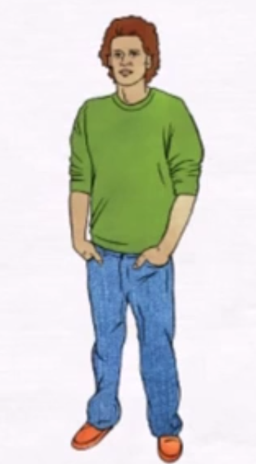
This is DIWAKAR !

Slide 4
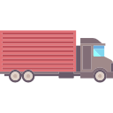


Diwakar, a new truck owner !
Still confused … how to get customers ?

Slide 5
now….This confusion forces him into the vicious circle of broker !!
AND NOW …
THE REAL PROBLEM
UNKNOWINGLY
BEGINS

Slide 6
LET US START
FROM THE BASICS
AND
DISCOVER
WHAT THE REAL PROBLEM IS
WITH THE
FREIGHT INDUSTRY !

Slide 7


Lets Talk about these problems one by one!!

Slide 8
Problems in Freight System -
Very scattered and fragmented.
Brokers eat almost 25% profit of the truck drivers.
Inefficient and irregular system.
ROBBERY
Revenue Generation

Slide 9
FRAGMENTATION
MARKET
BROKER A
EMPTY REGION
BROKER B
EMPTY REGION

Slide 10
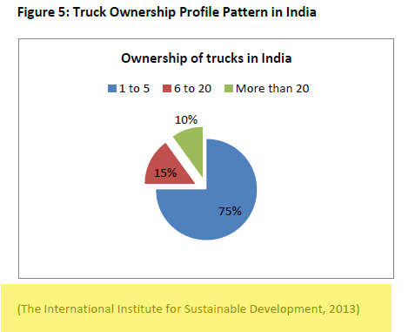
SCATTERED

Slide 11
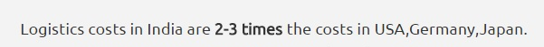

THE EXPLOITERS

Slide 12

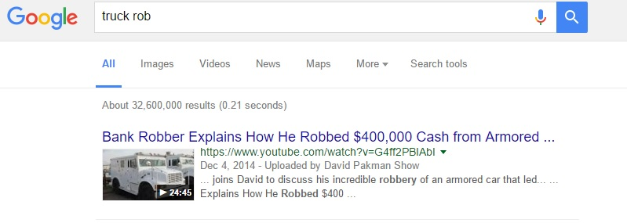
TRUCK ROBBERY

Slide 13
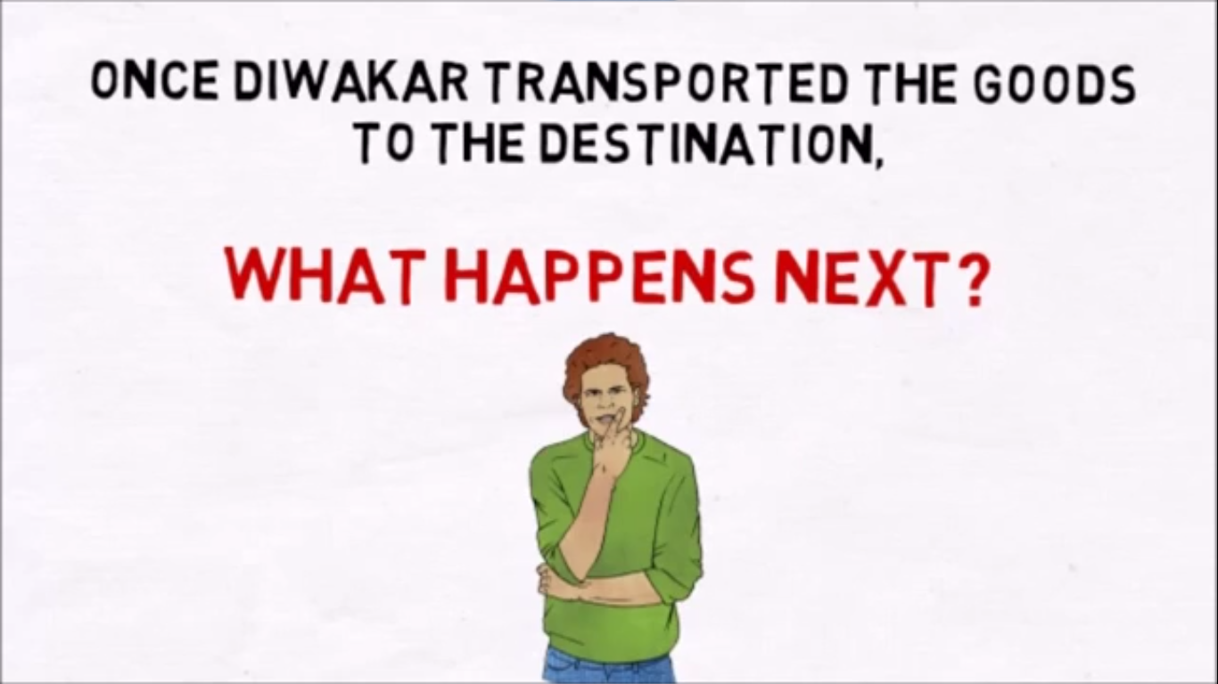

Slide 14
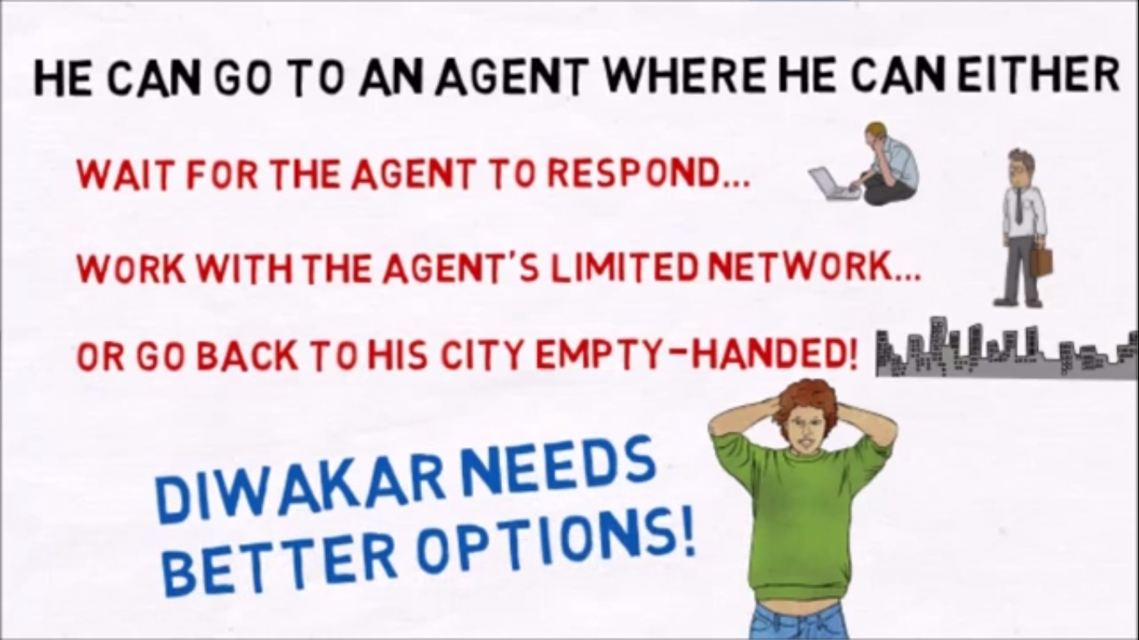

Slide 15
INDIA IS UNABLE TO PRODUCE EFFICIENT REVENUE
THROUGH LOGISTIC INDUSTRY
=
COST OF MOVING A LOADED TRUCK ~ COST OF MOVING A EMPTY TRUCK
NIL
EFFICIENT
OUTPUT

Slide 16
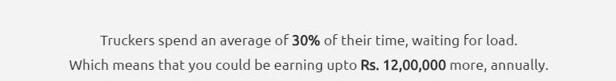

Revenue Generation

Slide 17
How to Solve these problems??
OUR PLAN

Slide 18

ANDRIOD APP

Slide 19
NO MORE A FRAGMENTED SYSTEM
WE AIM AT…
MARKET
OUR APP’S SPREAD

Slide 20
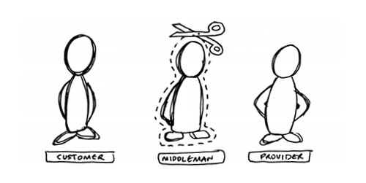
WE AIM AT…

Slide 21
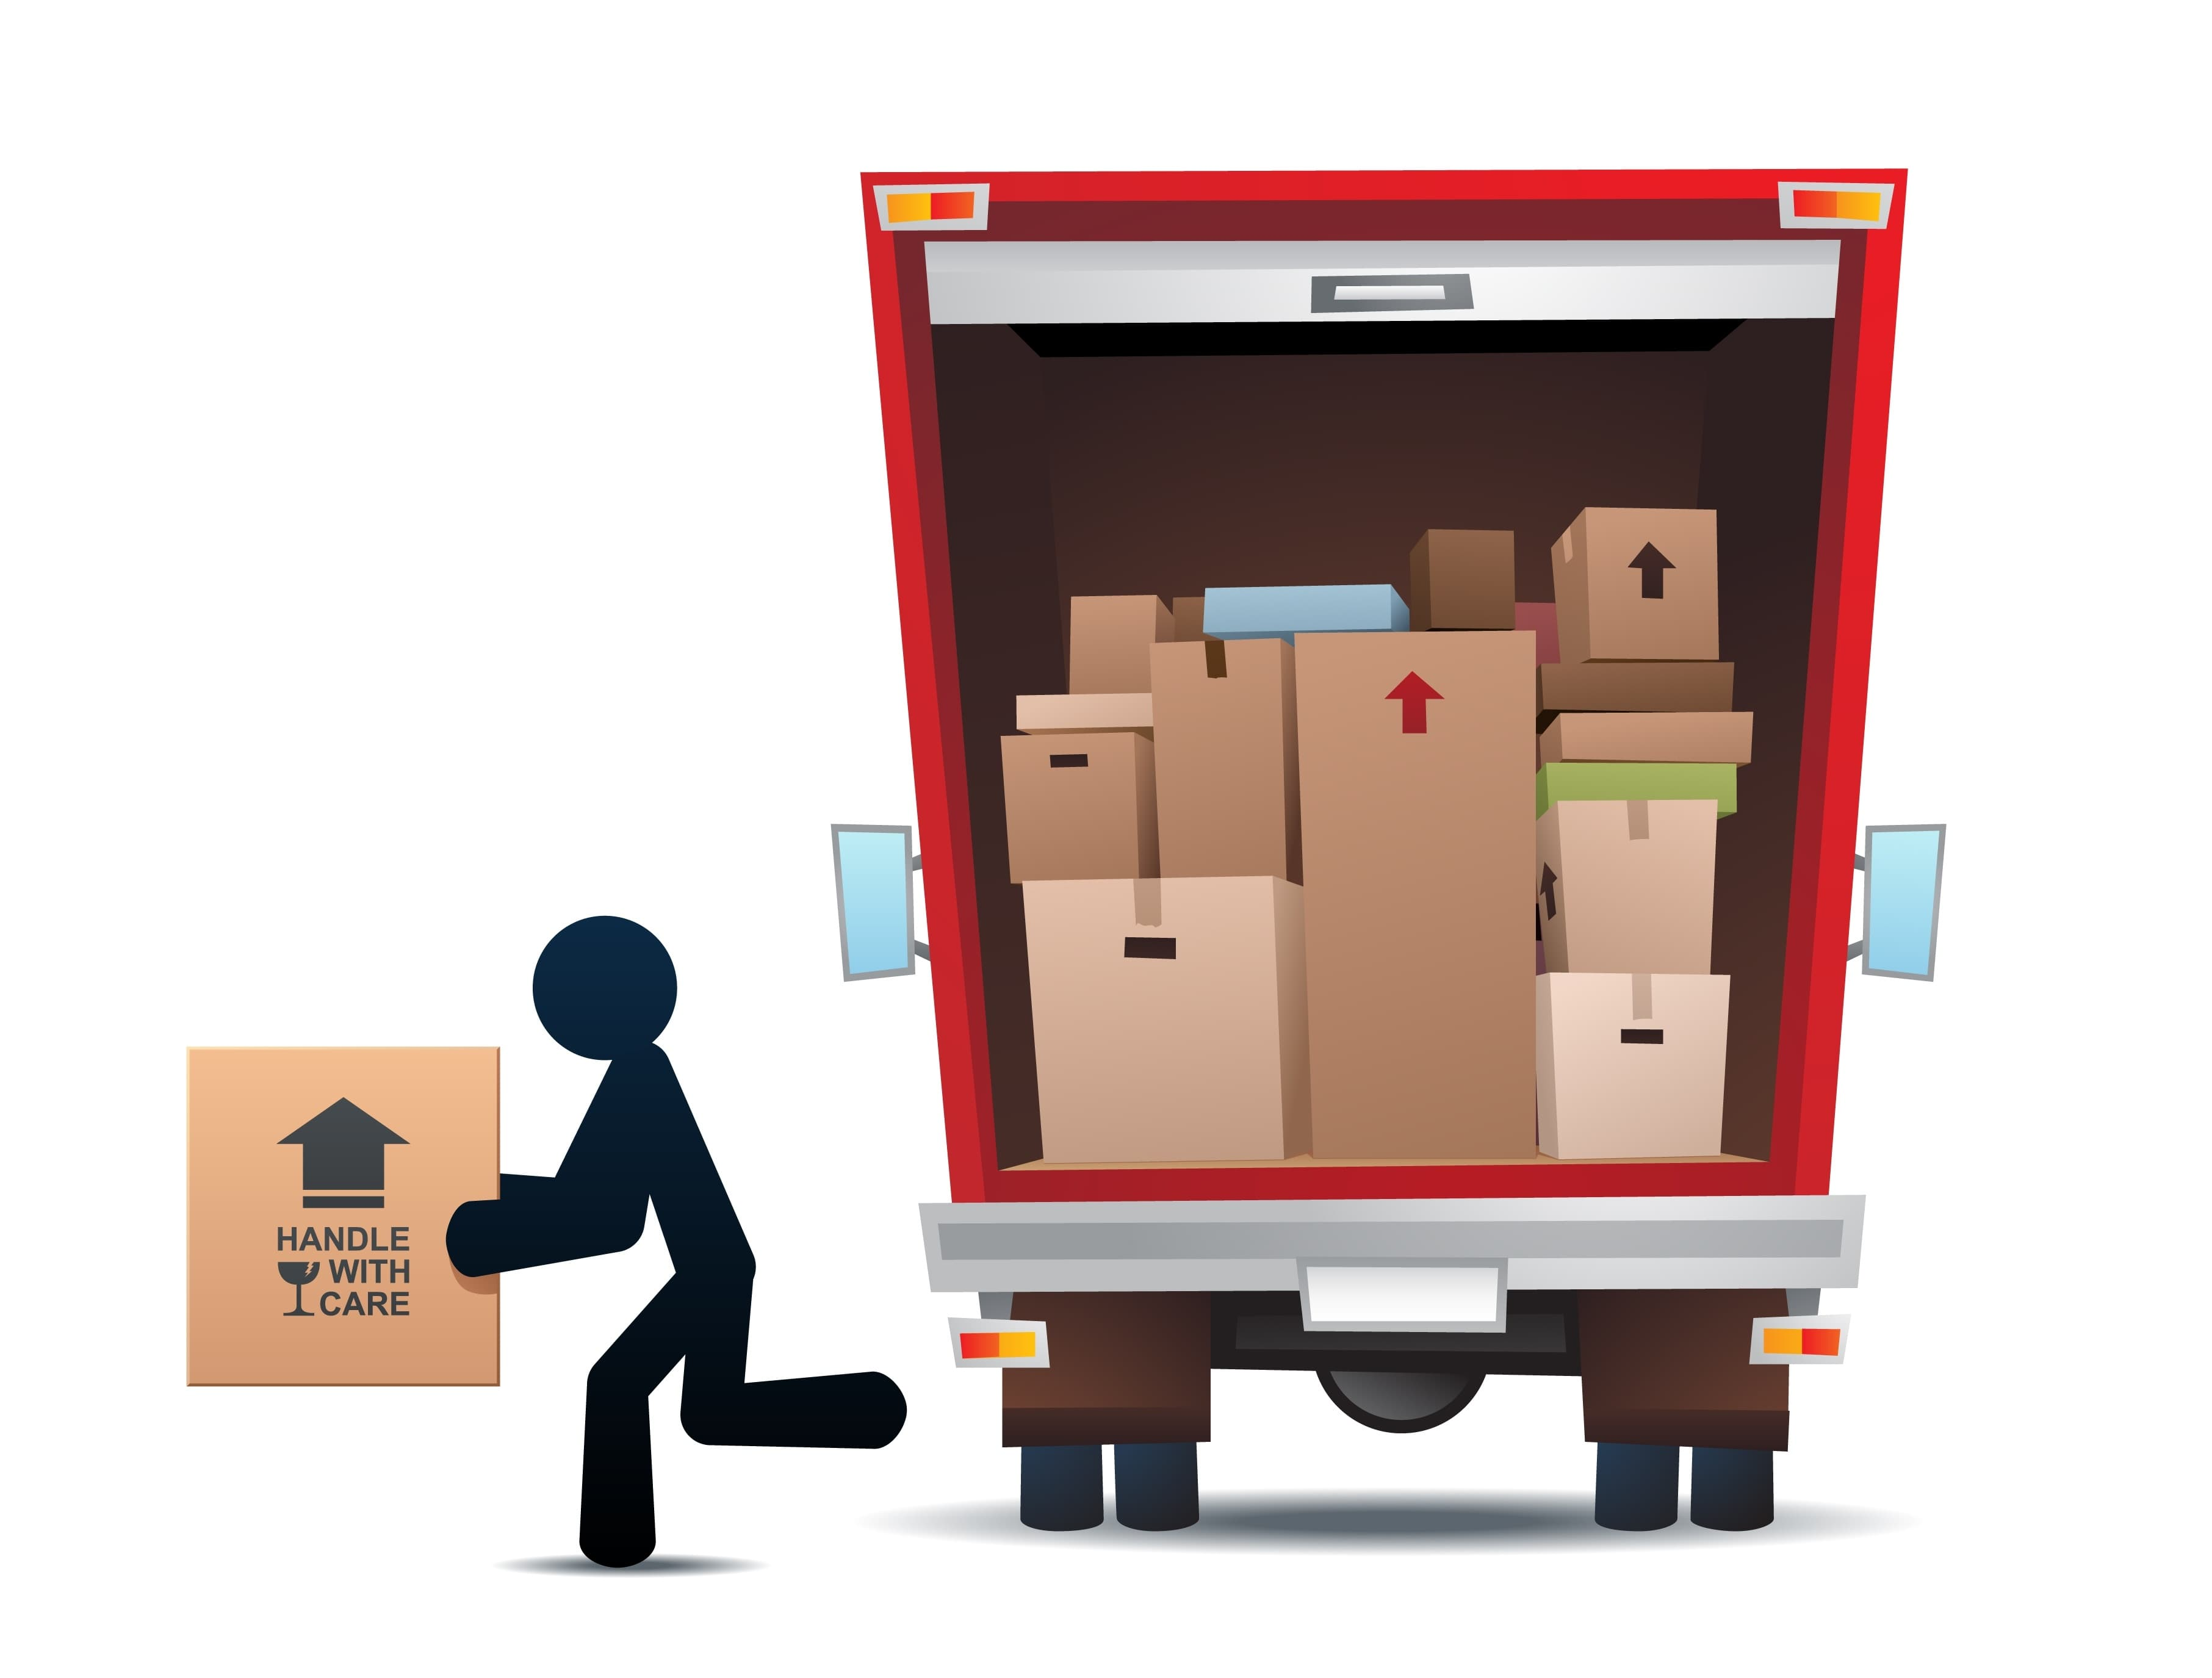
WE AIM AT…
S
T
O
P

Slide 22
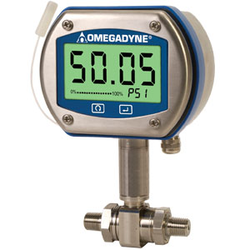
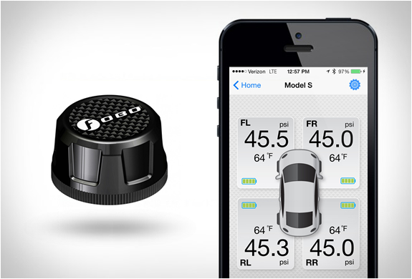
Digital Pressure Gauge
OR
FOBO Tire
Tire pressure monitoring
system(TPMS) with bluetooth
pairing that transmits
tire info to android device.

Slide 23
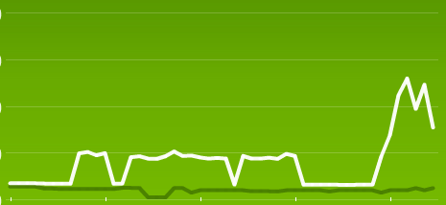
GRAPH
WEIGHT
TIME

Slide 24
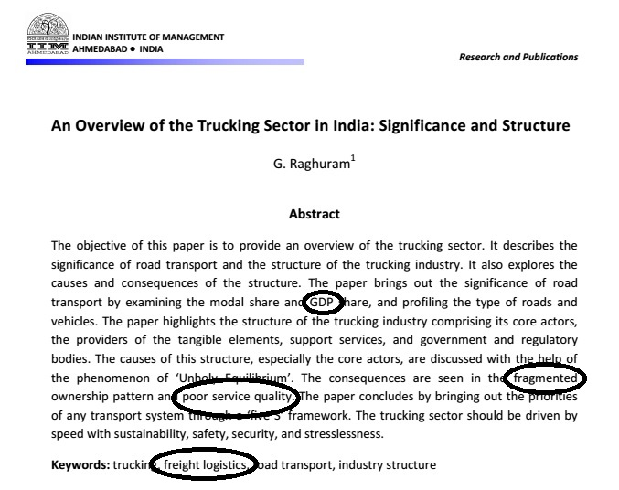


Slide 25
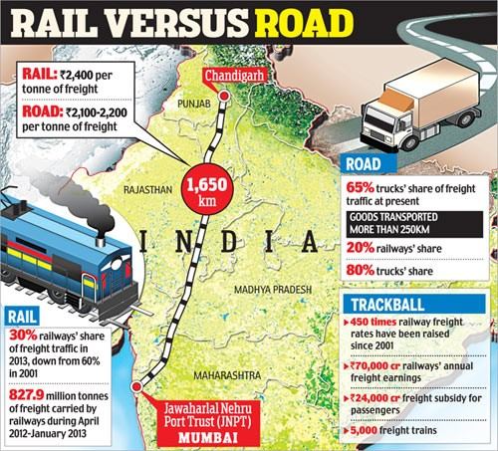

Slide 26
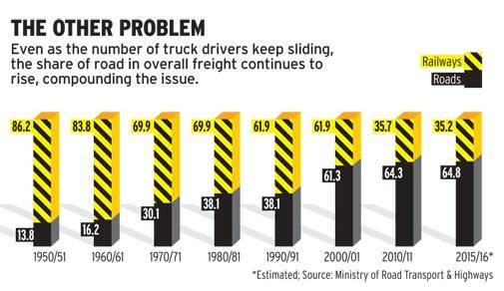
WHY IS THIS ISSUE BIG?
85% of India’s 3 million commercial vehicle belong to small fleet owners (less than 10 trucks) making the industry highly fragmented and allowing middlemen to eat up over 25% of trucker’s profile just for load matching.

Slide 27
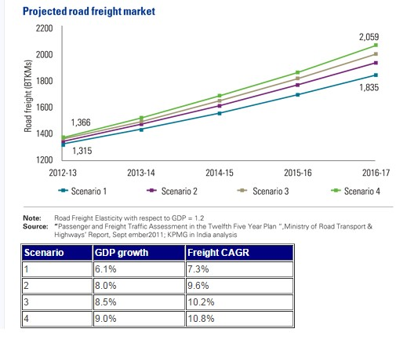
impact

Slide 28
WHAT ELSE CAN WE DO ?
OPTIONS
MAKE
LIFE EASY !
INTRODUCING BIDDING SYSTEM

Slide 29
LOAD SHARING
A
B
Truck Having Capacity of 5kg But user at A has 3kg of load
A
B
C
NEW user found at C who want to carry 2kg of load to C

Slide 30

USERS WILL POST THEIR LOAD
TRUCKER OWNERS WILL POST THEIR COST!
USER WILL SELECT THE BEST

Slide 31
RATING THE DRIVERS
After analysis of data for some months or a year…
truck drivers can be asigned different readings and on that basis
users can select the quality from the crowd !
This will be helpful at time of approving any bid over the other.

Slide 32
Thank You!!

